Slide 1

Network Imputation in Predicting Researcher Collaboration
Yun Huang¹, Chuang Zhang², Maryam Fazel-Zarandi³, Hugh Devlin¹, Alina Lungeanu¹, Stanley Wasserman ⁴, Noshir Contractor¹
¹ Science of Networks in Communities (SONIC),
Northwestern University
² Beijing University of Post and Telecommunication
³ Nuance Communications, Montreal, Canada
⁴ Indiana University
Supported by NSF grants CNS-1010904, OCI-0904356,
IIS-0838564 and NIH CTSA award UL1RR025741.

Slide 2
Social Science Guided Development of Tools to Recommend Collaborations
VIVO meets SciTS
Big data on scientific collaboration
Social science insights on effective team collaboration
Can theoretical models be used to guide development of tools to predict/recommend collaborations?
Implement algorithms based on advanced network analytic methodologies to make recommendations

Slide 3
Outline
Motivation and application
Expert recommender for collaboration
Multi-theoretical Multilevel Model (MTML) for effective collaboration
Modeling NUCATS co-proposal networks
Exponential Random Graph Models (ERGM/p*) as a recommender
Social theories and hypotheses
Experiment and evaluation
Benchmarks of data mining algorithms
Result comparison

Slide 4
Expert Recommender for Teams
Traditional use of link prediction models
To predict links that are present but not easily observed (e.g. in terrorist networks)
Novel use of link prediction models
To predict links that are not present but ought to be present to enable effective collaboration.
Technically, network imputation: Estimating missing nodes and missing links based on statistical modeling of networks (Wasserman, Robins, & Steinley, 2007)
Notes:
link prediction and missing link detection

Slide 5
Multi-theoretical Multilevel Models (MTML) for Effective Collaboration
MTML models provide an integrated explanatory framework to understand collaboration at multiple levels:
Actor level (e.g. individual attributes such as age, gender, tenure, and H-index)
Dyad level:
Attributes (e.g., shared university or disciplinary affiliation)
Relation (e.g., prior collaborations or citation ties)
Higher order - Relational (e.g., friend of a friend, coauthor of a coauthor, star collaborators in the network, etc.)

Slide 6

Using ERGM Network Analytic Methodologies to Estimate MTML Models for Effective Collaboration
Exponential Random Graph Models (ERGM) …
estimate the extent to which each hypothesized structure -- actor attribute, dyadic shared attribute, dyadic relational and higher order relational variable -- included in the MTML model explains the presence of effective collaboration ties observed in the network;
estimate the degree to which the theoretically hypothesized structures are likely to occur in observed networks;
consider an observed network x as a realization of an underlying random network X characterized by a set of network features and parameters:
Where:
θ is the vector of estimated MTML model parameters,
g(x) is a vector of the extent to which the hypothesized network configurations
occur in the observed collaboration network
κ(θ) is a normalizing quantity.

Slide 7
Proposal Collaboration
NUCATS co-proposal network
Northwestern University Clinical and Translational Sciences
63 proposal teams with 147 researchers and 100 co-proposal relations
MTML factors influencing collaboration:
Impacts of gender, tenure, professional experience, co-authorship, citations, and network structures on their collaboration relations

Slide 8
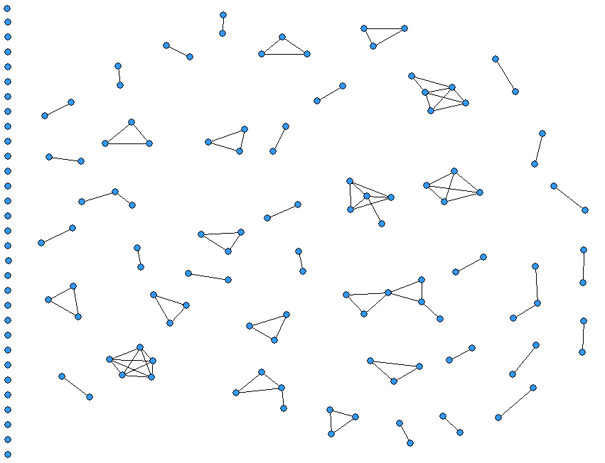
Co-proposal Relations

Slide 9
ERGM Model for Team Assembly
Levels | Variables | Odds ratio
Actor (attributes) | Gender (1= “female”) | 1.82*
 | Tenure (Log years since PhD) | 0.51*
 | Experience (Ln Publication) | 1.20*
Dyad (attributes) | Gender difference | 0.55*
 | Tenure difference | 0.99
 | Experience difference | 0.72*
Dyad (relations) | Co-authorship | 9.03*
 | Citation relationship | 0.65*
Higher order | Edge (co-proposal) | 0.00*
 | Weighed node degree | 323.76*
 | Weighed number of shared neighbors | 70.11*
Log Likelihood |  | -356.36
Significance codes: * p<0.001; estimated using Statnet (Handcock et al 2008)

Slide 10
ERGM Model for Team Assembly
Levels | Variables | Odds ratio
Actor (attributes) | Gender (1= “female”) | 1.82*
 | Tenure (Log years since PhD) | 0.51*
 | Experience (Ln Publication) | 1.20*
Dyad (attributes) | Gender difference | 0.55*
 | Tenure difference | 0.99
 | Experience difference | 0.72*
Dyad (relations) | Co-authorship | 9.03*
 | Citation relationship | 0.65*
Higher order | Edge (co-proposal) | 0.00*
 | Weighed node degree | 323.76*
 | Weighed number of shared neighbors | 70.11*
Log Likelihood |  | -356.36
Significance codes: * p<0.001; estimated using Statnet (Handcock et al 2008)
Female and researchers with more publications are more likely to collaborate but tenure has a negative effect.

Slide 11
ERGM Model for Team Assembly
Levels | Variables | Odds ratio
Actor (attributes) | Gender (1= “female”) | 1.82*
 | Tenure (Log years since PhD) | 0.51*
 | Experience (Ln Publication) | 1.20*
Dyad (attributes) | Gender difference | 0.55*
 | Tenure difference | 0.99
 | Experience difference | 0.72*
Dyad (relations) | Co-authorship | 9.03*
 | Citation relationship | 0.65*
Higher order | Edge (co-proposal) | 0.00*
 | Weighed node degree | 323.76*
 | Weighed number of shared neighbors | 70.11*
Log Likelihood |  | -356.36
Significance codes: * p<0.001; estimated using Statnet (Handcock et al 2008)
Gender and experience homophily has a positive impact on collaboration. Tenure similarity has no effect.

Slide 12
ERGM Model for Team Assembly
Levels | Variables | Odds ratio
Actor (attributes) | Gender (1= “female”) | 1.82*
 | Tenure (Log years since PhD) | 0.51*
 | Experience (Ln Publication) | 1.20*
Dyad (attributes) | Gender difference | 0.55*
 | Tenure difference | 0.99
 | Experience difference | 0.72*
Dyad (relations) | Co-authorship | 9.03*
 | Citation relationship | 0.65*
Higher order | Edge (co-proposal) | 0.00*
 | Weighed node degree | 323.76*
 | Weighed number of shared neighbors | 70.11*
Log Likelihood |  | -356.36
Significance codes: * p<0.001; estimated using Statnet (Handcock et al 2008)
Researchers are more likely to collaborate with co-authors and others less cited with each other.

Slide 13
ERGM Model for Team Assembly
Levels | Variables | Odds ratio
Actor (attributes) | Gender (1= “female”) | 1.82*
 | Tenure (Log years since PhD) | 0.51*
 | Experience (Ln Publication) | 1.20*
Dyad (attributes) | Gender difference | 0.55*
 | Tenure difference | 0.99
 | Experience difference | 0.72*
Dyad (relations) | Co-authorship | 9.03*
 | Citation relationship | 0.65*
Higher order | Edge (co-proposal) | 0.00*
 | Weighed node degree | 323.76*
 | Weighed number of shared neighbors | 70.11*
Log Likelihood |  | -356.36
Significance codes: * p<0.001; estimated using Statnet (Handcock et al 2008)
Researchers are not likely to randomly collaborate and have a similar number of collaborators and a high level of transitivity.

Slide 14
Re-purposing Link Prediction Models for Making Link Recommendation
Link prediction models are used to predict links that are present but were not observed (as in covert networks).
A key contribution of this study is to repurpose the use of link prediction models for predicting links that are not present but ought to be present – a recommendation.

Slide 15
Comparing MTML Link Prediction Approaches to Traditional Link Prediction Approaches
Node-wise similarity approaches
Define or learn a measure of similarity between two nodes to determine link existence
Probabilistic model based approaches
Abstract the underlying structure from the observed data network to a compact probabilistic model. Regenerate the unobserved part of the network using the learned model.
Network topology based approaches
Exploit topological pattern, ranging from local patterns around the nodes to the global patterns covering the entire social network.
Notes:
Topology: The intuition of such methods for link prediction is that link existence should consist with the patterns in the current network.

Slide 16
Comparing MTML Link Prediction with …
Three benchmark data mining approaches
Node-wise similarity-based approach
Relational Bayesian Networks (Jaeger 1997)
The Katz Method (Katz 1953)
Remove exactly one link that is known to exist in the collaboration network and assess how well (with high rank) each approach recommends that link be created
Evaluate efficacy of four approaches using Average Rank of the Correct Recommendation (ARC) (Burke 2005)
Notes:
The reason why we choose these benchmarks is that they use the variables in the way similar to p*:
Node-wise Similarity ~ p* node attribute difference
Katz distance ~ p* gwesp
PRM ~ p* dyadic covariates

Slide 17
Example: Predicting Link b to d
Observed network x
Ranks of recommendations
b
The rank of the correct prediction (link x_{bd}) is
2
(Ideally the model should recommend adding a link from b to d with the highest probability, i.e. ranking Top 1)
1. P(Xbc=1|X=x*) = 0.4
2. P(Xbd=1|X=x*) = 0.3
3. P(Xcd=1|X=x*) = 0.2
4. P(Xac=1|X=x*) = 0.1
c
a
d
3. Rank all links recommended based on their probabilities
1. Remove link from b to d
Training network x*
Link probabilities
b
b
0.4
c
c
a
0.1
0.3
a
0.2
2. Build a model and calculate the probability for all links which are not in the training network x*
d
d
Notes:
Jackknifing

Slide 18
 | Links |  | Ranks
Test | Node i | Node j | Node-wise | RBN | Katz | ERGM
1 | 1 | 26 | 5443 | 7414 | 5323.5 | 4522
2 | 3 | 126 | 951 | 149 | 5325 | 695
3 | 5 | 54 | 3710 | 2 | 5325 | 83
4 | 6 | 60 | 2272 | 198.5 | 5325 | 1154
5 | 7 | 110 | 3710 | 7414 | 15 | 100
6 | 7 | 127 | 951 | 7414 | 15 | 96
7 | 8 | 137 | 10333.5 | 2 | 5325 | 67
8 | 10 | 114 | 5443 | 72 | 15 | 63
9 | 10 | 141 | 3710 | 54.5 | 15 | 59
10 | 11 | 77 | 2272 | 198.5 | 5325 | 733
11 | 12 | 15 | 6573 | 2630 | 3 | 74
12 | 12 | 27 | 8598 | 113.5 | 3 | 63
13 | 12 | 34 | 5443 | 7414 | 3 | 96
…
100 | 133 | 142 | 8598 | 33 | 1.5 | 61
Average |  |  | 5155 | 3381 | 1657 | 603

Slide 19
ARC – The average rank with which the correct (missing) link was recommended by each of the four approaches
As a base line: the ARC for a random guess is 5316
Methods | Average Rank of the Correct Recommendation (std. dev.)
 | Actor level | Dyad level | High Order | All variables
Node-wise similarity | 5155 (3243)
RBN |  | 3381 (3217)
Katz |  |  | 1657 (2471)
ERGM |  |  |  | 603 (1148)
Not that impressive, but the ARC for a random guess is 5,316 because ranks range from one to10,632 (all possible links in a network of 147 researchers
Notes:
147 researchers -> 10731 possible (undirected) links – 100 observed + 1 removed observed = 10632 is the worst possible rank; the ARC for a random guess is 5316
Explain the results

Slide 20
ARC – The average rank with which the correct (missing) link was recommended by each of the four approaches
As a base line: the ARC for a random guess is 5316
Methods | Average Rank of the Correct Recommendation (std. dev.)
 | Actor level | Dyad level | High Order | All variables
Node-wise similarity | 5155 (3243)
RBN |  | 3381 (3217)
Katz |  |  | 1657 (2471)
ERGM |  |  |  | 603 (1148)
Similar to the findings in Liben-Nowell and Kleinburg, 2007, the Katz method has the best performance among the benchmark models. High order relational structures provide critical information for the predictions and dyad level only makes a small marginal contribution.
Notes:
147 researchers -> 10731 possible (undirected) links – 100 observed + 1 removed observed = 10632 is the worst possible rank; the ARC for a random guess is 5316
Explain the results

Slide 21
ARC – The average rank with which the correct (missing) link was recommended by each of the four approaches
As a base line: the ARC for a random guess is 5316
Methods | Average Rank of the Correct Recommendation (std. dev.)
 | Actor level | Dyad level | High Order | All variables
Node-wise similarity | 5155 (3243)
RBN |  | 3381 (3217)
Katz |  |  | 1657 (2471)
ERGM |  |  |  | 603 (1148)
The final ERGM model utilizes all variables and achieves the best performance.
Notes:
147 researchers -> 10731 possible (undirected) links – 100 observed + 1 removed observed = 10632 is the worst possible rank; the ARC for a random guess is 5316
Explain the results

Slide 22
ARC – The average rank with which the correct (missing) link was recommended by each of the four approaches
As a base line: the ARC for a random guess is 5316
Methods | Average Rank of the Correct Recommendation (std. dev.)
 | Actor level | Dyad level | High Order | All variables
Node-wise similarity | 5155 (3243)
RBN |  | 3381 (3217)
Katz |  |  | 1657 (2471)
ERGM | 4587 (3231) | 3751 (2855) | 803 (1370) | 603 (1148)
ERGM models have better performance both in terms of the average rank and consistency of predictions compared to the benchmark models using similar variables.
Notes:
147 researchers -> 10731 possible (undirected) links – 100 observed + 1 removed observed = 10632 is the worst possible rank; the ARC for a random guess is 5316
Explain the results

Slide 23
 | Links |  | Ranks
Test | Node i | Node j | Node-wise | RBN | Katz | Best
1 | 1 | 26 | 5443 | 7414 | 5323.5 | 5323.5
2 | 3 | 126 | 951 | 149 | 5325 | 149
3 | 5 | 54 | 3710 | 2 | 5325 | 2
4 | 6 | 60 | 2272 | 198.5 | 5325 | 198.5
5 | 7 | 110 | 3710 | 7414 | 15 | 15
6 | 7 | 127 | 951 | 7414 | 15 | 15
7 | 8 | 137 | 10333.5 | 2 | 5325 | 2
8 | 10 | 114 | 5443 | 72 | 15 | 15
9 | 10 | 141 | 3710 | 54.5 | 15 | 15
10 | 11 | 77 | 2272 | 198.5 | 5325 | 198.5
11 | 12 | 15 | 6573 | 2630 | 3 | 3
12 | 12 | 27 | 8598 | 113.5 | 3 | 3
13 | 12 | 34 | 5443 | 7414 | 3 | 3
…
100 | 133 | 142 | 8598 | 33 | 1.5 | 1.5
Average |  |  | 5155 | 3381 | 1657 | 414

Slide 24
ARC – The average rank with which the correct (missing) link was recommended by each of the four approaches
As a base line: the ARC for a random guess is 5316
Methods | Average Rank of the Correct Recommendation (std. dev.)
 | Actor level | Dyad level | High Order | All variables
Node-wise similarity | 5155 (3243)
RBN |  | 3381 (3217)
Katz |  |  | 1657 (2471)
ERGM |  |  |  | 603 (1148)
Best | Node-wise + RBN + Katz < 414 (1082)

Slide 25
Summary
p* models provides an analytic methodology to implement insights from social science theory driven models of effective collaboration into recommender systems
Recommendations made using social science driven ERGMs outperform traditional link prediction models in making recommendations …
Illustrating the potential of theory-driven over purely data-driven recommender systems for collaboration

Slide 26
Thank you. Questions?

Slide 27
Using ERGM/p* network analytic methodologies to estimate MTML models for effective collaboration
Exponential Random Graph Models (ERGM) estimate the extent to which each hypothesized structure -- actor attribute, dyadic shared attribute, dyadic relational and higher order relational variable -- included in the MTML model explains the presence of effective collaboration ties observed in the network.
Estimates the degree to which the theoretically hypothesized structures are likely to occur in observed networks (Frank & Strauss, 1986; Robins & Pattison, 2005; Wasserman & Pattison, 1996)
Consider an observed network x as a realization of an underlying random network X characterized by a set of network features and parameters (based on Hammersley-Clifford theorem and homogeneity assumption):
Where:
θ is the vector of estimated MTML model parameters,
g(x) is a vector of the extent to which the hypothesized network configurations
occur in the observed collaboration network
κ(θ) is a normalizing quantity.

Slide 28
p* / Exponential Random Graph Models
Estimates the degree to which the theoretically hypothesized structures are likely to occur in observed networks (Frank & Strauss, 1986; Robins & Pattison, 2005; Wasserman & Pattison, 1996)
Consider an observed network x as a realization of an underlying random network X characterized by a set of network features and parameters (based on Hammersley-Clifford theorem and homogeneity assumption):
where θ is a vector of model parameters,
g(x) is a vector of the statistics of network configurations, and
κ(θ) is a normalizing quantity.

Slide 29
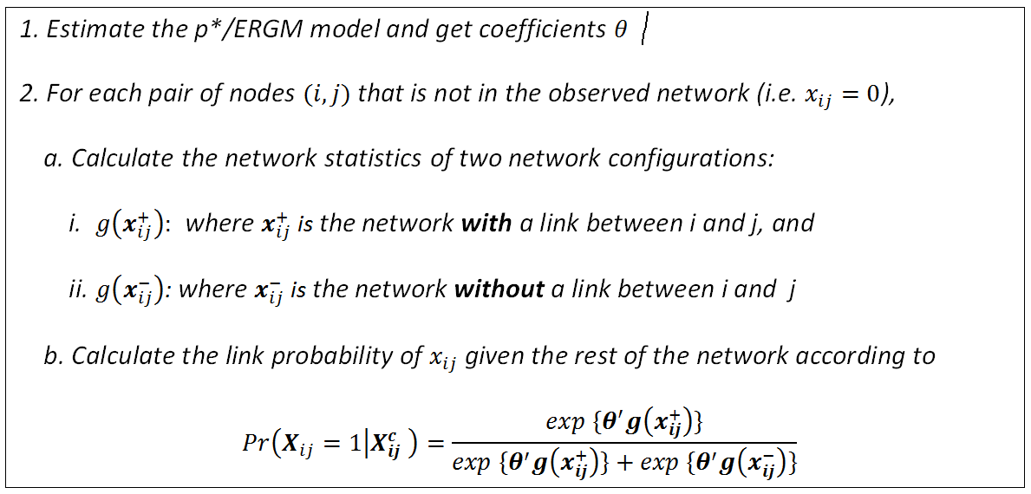
Use p* Models to Calculate Link Probability

Slide 30
Models Using Different Variables
Category | Variables | Model 1 | Model 2 | Model 3 | Model 4
Network structures | Edge (co-proposal) | -4.69 *** | -12.85*** | -4.89*** | -14.25***
 | Weighed node degree (GWD) |  | 4.46*** |  | 5.78***
 | Weighed number of shared neighbors (GWESP) |  | 3.97*** |  | 4.25***
Attribute effect | Gender (1= “female”) | 0.40** |  |  | 0.60***
 | Tenure (Log years since PhD) | -0.06 |  |  | -0.67***
 | Experience (Ln Publication) | -0.003 |  |  | 0.18***
Similarity | Gender difference | -0.40` |  |  | -0.59***
 | Tenure difference | -0.009 |  |  | -0.009
 | Experience difference | 0.06 |  |  | -0.33***
Covariate dyad | Co-authorship |  |  | 2.16*** | 2.20***
 | Citation relationship |  |  | -0.47* | -0.43***
Log Likelihood |  | -563.14 | -410.61 | -506.75 | -356.36
Significance codes: *** p<0.001 ** p<0.01 * p<0.05 ` p<0.1 estimated using Statnet (Handcock et al 2008)
Notes:
Why need models 1-3: need to the prediction power of variables in different categories.

Slide 31

Predict Link Probability in p*
Likelihood of a random network with link (i,j) given an observed network x:
Pr( X_{ij} = 1| X = x)
where X_{ij} is an element of a random network X: X_{ij} =1 if (i, j) ϵ L; X_{ij} =0 otherwise
Calculate the probability using the statistics of network configurations
where X^{c}_{ij} is the rest of the observed network other than the link x_{ij},
x⁺_{ij} and x⁻_{ij} are the network realized by fixing x_{ij}=1 and x_{ij}=0, respectively

Slide 32

Benchmark 1: Node-wise Similarity
Likelihood of link existence between two nodes is determined by a similarity score (i.e. whether they have many common features)
Link prediction can be transformed into a supervised binary classification problem
where F^{ij} is a vector containing n features obtained from mapping the feature vectors of nodes i and j to a single vector
Two models
Node-wise similarity based on nodal features: the absolute differences of gender, tenure, and experience
Node-wise similarity based on network structures: number of common neighbors
Naive Bayes algorithm is used to calculate probabilities
Notes:
simplest framework of link prediction methods

Slide 33

Benchmark 2: The Katz Method
Ensemble of all paths between two nodes in the network is considered by directly summing over the collection of paths
Exponentially damped by length to consider shorter paths more heavily
Three models:
Katz using network structures: paths are calculated based on the co-proposal network.
Katz using Dyadic covariates: paths are calculated based on co-authorship and citation networks.
Katz using all variables: paths are calculated based on co-proposal, co-authorship, and citation networks.
Set of all paths of length l connecting i and j
Damping factor
Notes:
One of the oldest and widely used topological pattern based approaches is the Katz measure
the Katz measure and its variants perform consistently well
β=0.001

Slide 34

Benchmark 3: Relational Bayesian Networks
Learn a compact model of the probability distribution given an observed social network
A directed acyclic graph and a set of conditional probability tables
Extends Bayesian network models by representing objects, their attributes and their relations with other objects.
Both nodes and links are considered as variables in these models
The joint probabilistic distribution can be factorized according to the dependencies in the acyclic graph structure (Friedman 1999):

Slide 35
RBN Relational Models
Researcher i
(Gender, tenure, experience)
Researcher j
(gender, tenure, experience)
Gender diff.
Tenure diff.
Experience diff.
Co-Author
Citation
Co-Author
Citation
Co-Proposal
Co-Proposal
Figure b: Bayesian network inference graph (DAG)
Figure a:PRM model graph
The model graph of RBN is a directed acyclic graph (DAG) with a set of conditional probability distributions (CPD) to represent a joint distribution over the attributes of researchers and their relations.
Notes:
Figure2: Bayesian network inference graph (DAG)

Slide 36
Summary of Experiment Procedure
For each method perform:
Remove one link (i,j) from x and create a network x*
Use the network x* to train a prediction model
Use the model to calculate link probability/score for all non-observable links in x*
Calculate link rank for the probability of link (a,b) among all non-observable links in x*: Rank(P(X_{ij} =1|X= x*)
Repeat steps 1-4 for all observed links in x
Calculate the average rank: ARC=average(Rank(P(X_{ij} =1|X= x*)))

Slide 37
Top K Precision and Recall for Four Methods
 | Top 100 |  | Top 500 |  | Top 1000
Methods | precision | recall | precision | recall | precision | recall
p* methodology | 0.0045 | 0.45 | 0.0015 | 0.73 | 0.00084 | 0.84
Node-wise similarity | 0 | 0 | 0 | 0 | 0.00021 | 0.21
Katz | 0.0069 | 0.69 | 0.0014 | 0.69 | 0.00069 | 0.69
RBN | 0.0023 | 0.23 | 0.0007 | 0.37 | 0.00038 | 0.38

Slide 38
Future Directions
Validate in real application scenarios
Need more testing data sets (NU Scholars)
Compare with more approaches
We only chose three relatively simple benchmark algorithms
Adapt it for reasoning and queries
Move the recommendation based on the complete information to the on-the-fly scenario

